Slide 1


Green Pace
Security Policy Presentation
Developer: Sarah Brady
https://youtu.be/kMXtCZammEQ

Slide 2

OVERVIEW: DEFENSE IN DEPTH

Slide 3
THREATS MATRIX
Secure Coding
Standards has
Vulnerability levels
that measure each
standard. The chart
gives an explanation
and prioritizes each
standard and level.
Likely Threats are very likely to happen. STD-002-CPP STD-003-CPP STD-004-CPP STD-005-CPP | Priority Standard with high relevancy STD-001-CPP STD-002-CPP STD-003-CPP STD-004-CPP STD-005-CPP
Low priority Standard with low relevancy STD-006-CPP STD-007-CPP | Unlikely Threats are not likely to happen STD-001-CPP STD-006-CPP STD-010-CPP

Slide 4
10 PRINCIPLES
Validate Input Data
STD-001-CPP, STD-002-CPP, STD-003-CPP, STD-004-CPP, STD-007-CPP, STD-008-CPP, STD-010-CPP
Heed Compiler warnings
STD-002-CPP, STD-003-CPP, STD-008-CPP, STD-009-CPP
Architect and Design for Security Policies
STD-003-CPP, STD-006-CPP, STD-007-CPP, STD-008-CPP, STD-009-CPP, STD-010-CPP
Keep It Simple
STD-003-CPP, STD-004-CPP, STD-005-CPP, STD-006-CPP, STD-007-CPP, STD-008-CPP, STD-009-CPP, STD-010-CPP
Default Deny
STD-008-CPP
Adhere to the Principle of Least Privilege
STD-006-CPP, STD-009-CPP, STD-010-CPP
Sanitize data Sent to Other Systems
STD-004-CPP, STD-010-CPP
Practice Defense in Depth
STD-004-CPP, STD-005-CPP, STD-006-CPP, STD-007-CPP, STD-008-CPP, STD-009-CPP
Use Effective Quality Assurance Techniques
STD-009-CPP, STD-010-CPP
Adopt a Secure Coding Standard
STD-009-CPP, STD-010-CPP

Slide 5
CODING STANDARDS
Do not cast to an out-of-range enumeration value
Use valid references, pointers, and iterators to reference elements of
a container
Do not attempt to create a std::string from a null pointer
Do not store already-owned pointer value in an unrelated smart
pointer
Properly deallocate dynamically allocated resources
Use a static assertion to test the value of a constant expression
Handle all exceptions thrown before main() begins executing
Do not alternately input and output from a file stream without an
intervening positioning call
Do not invoke virtual functions from constructors or destructors
Value returning functions must return a value from all exit paths

Slide 6
ENCRYPTION POLICIES
Encryption in rest
Stored passwords will be stored in a secure manner. All data must be encrypted to prevent unauthorized access. Encryption will change and stay up to date with technology changes. If an attacker gains accesses to a system with encrypted data but not the encryption keys, the attacker must decipher the encryption in order to read the data.
Encryption at flight
Data communications will be done in a secure manner along with identification of the data recipient to prevent interception of data.
Encryption in use
Data that is in use will be muddled at any point that is practical. Heavily used data will also be encrypted when in rest then unencrypted when being used.

Slide 7
TRIPLE-A POLICIES
Authentication
Identifies a user in order to administer a security policy. This occurs during the login stage. Some updated methods use multilayer step authentication.
Authorization
Identifies the user and determines the user’s authorization. Also determined on a case-by-case basis along with device and location. It is a level of access that user has in a system, whether the user is reading, modifying ot deleting files in the database.
Accounting
Logs each transaction which may need to be investigated for malicious activity if an attack or breach occurs. Accounting is very important as this determines where security threats, attacks or breaches initiated from and the cause. Every system will need to be logged in order for this be effective.

Slide 8
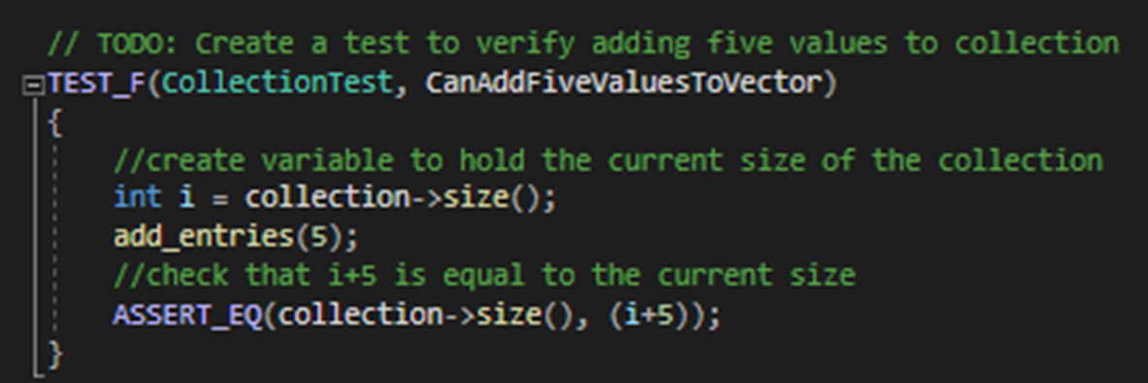
Unit Testing
CanAddFiveValuesToVector:

Slide 9

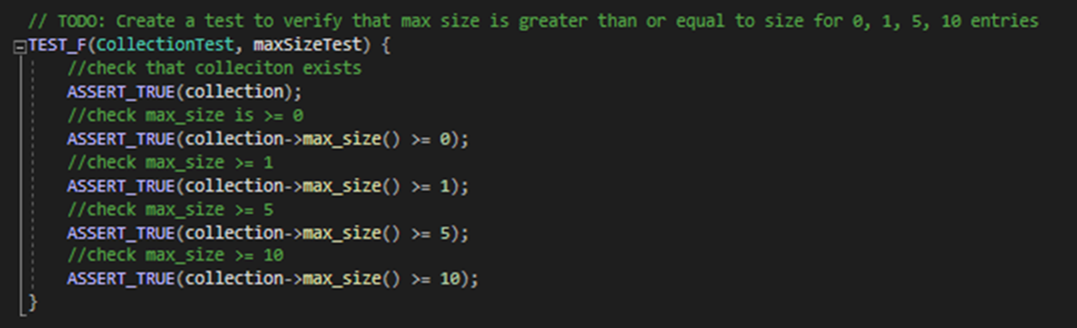
Unit Testing

Slide 10

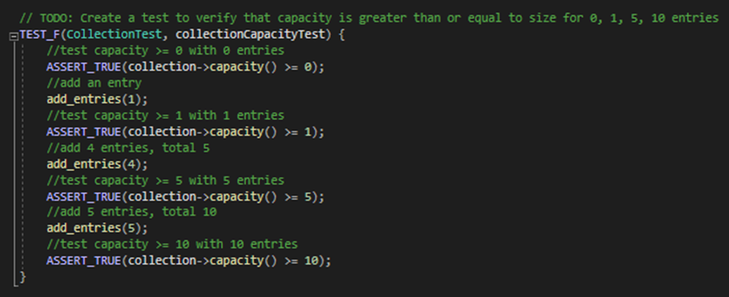
Unit Testing

Slide 11

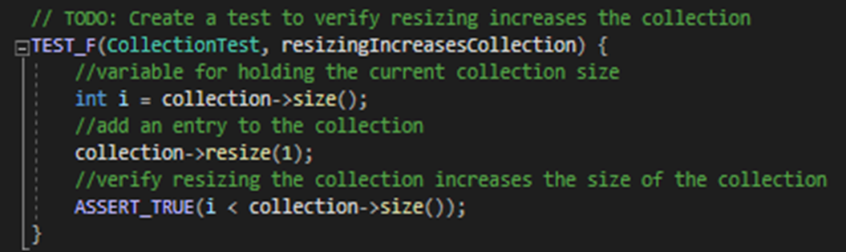
Unit Testing

Slide 12

AUTOMATION SUMMARY

Slide 13
TOOLS
The DevSecOps pipeline is a method of secure coding that enforces a security policy.
Plan, Design and development
Code and build
Test for vulnerabilities
Vulnerability Scanning
Release
Log and audit
Automated Penetration Testing
Monitor and Detect
Automated Response
Recover

Slide 14
RISKS AND BENEFITS
Risks are always a potential concern when building code, but continuous security practices will keep those risks at bay. Following policies and continuing training is vital to a successful and secure system.
Risks
Automation can be prone to errors
Actions to take
Always practice and be up to date with static analysis tools and static testing.
Follow and practice the coding standards and principles.

Slide 15
RECOMMENDATIONS
Continue to keep with current security trends to maintain the proper level of security.
Follow security standards
Automate
Proper code testing for maintain defense

Slide 16
CONCLUSIONS
Throughout this presentation, we touched on the principles and standards of secure coding and have concluded that practicing and maintaining secure coding is vital for the protection of sensitive data and information. Understanding multilevel security as well as the tools of the DevSecOps pipeline along with the risks and benefits will lead to the continuous practice and staying up to date with current trends within technology security.
Taking these recommendations and using them as followed with ensure the protection that every organization strives for.

Slide 17
REFERENCES
Carnegie Mellon University. (2020). SEI CERT C++ Coding Standard. Retrieved from Carnegie Mellon University : https://wiki.sei.cmu.edu/confluence/pages/viewpage.action?pageId=88046682
Cprogramming.com. (2019). XOR Encryption in C++. Retrieved from Cprogramming.com: https://www.cprogramming.com/tutorial/xor.html
Google. (2022). DevOps tech: Shifting left on security. Retrieved from Google Cloud: https://cloud.google.com/architecture/devops/devops-tech-shifting-left-on-security
Seacord, R. (2020, November 18). Confluence. Retrieved from SEI External Wiki Home: https://wiki.sei.cmu.edu/confluence/

